Slide 1
Tutorial 4
Delivered Jinghao Jiang

Slide 2
Scheduling
Delivered Jinghao Jiang

Slide 3
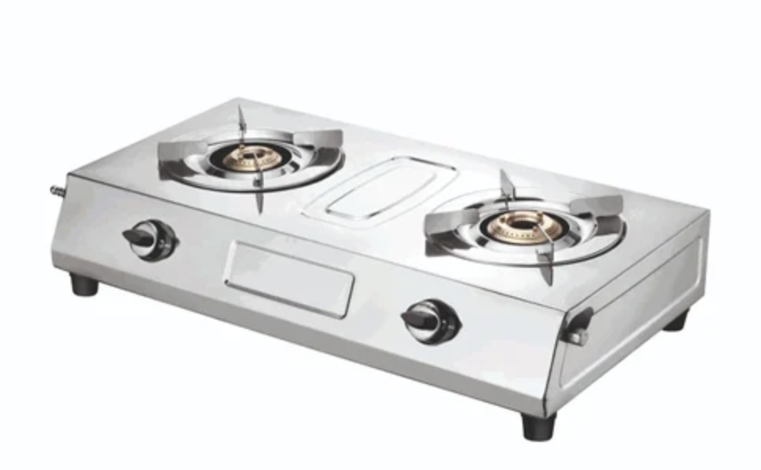
Scheduling
On a computer, we have limited cpus, but many concurrent running tasks.
The scheduler is like the chef of a kitchen. Many diners arrive at the same time, with different orders. Its job is to satisfy as many diners as possible with limited number of stove.

Slide 4

Why scheduling
Even in real life, different tasks have different priority.
(e.g NZQA unit standard 12349)
Many factors influence priority of a task (e.g deadline, importance)
Scheduler ← unit that determines importance and execution order of processes. (so no single scheduler is the best, different designs may have different benefits)

Slide 5


Process becomes runnable
Scheduler allocates a cpu for the process to run
load process data into registers then run (in user mode)
May happen in between: request sys_service/exception/interrupt
Store current process states, enter kernel mode
Kernel do operations in trust memory, return back to user with saved states
Process yields cpu to another process due to exit/preemption
If preemption, save state of the current process

Slide 6

Scheduler performance
Wating time
Response time
Turnaround time
Throughput
Cpu utilization
Fairness
…
Pid = *

Slide 7
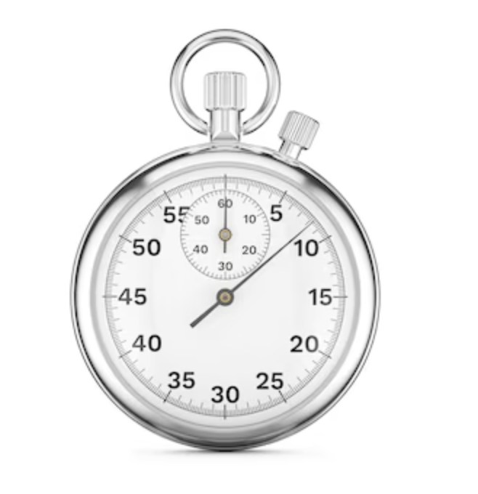
Scheduling policy
FCFS: early arriving process executes first until finish (No preemption)
SJF: shortest job at instance of choosing a process, process occupy cpu until finish (No preemption)
SRTF: job with shortest remaining burst time executes first (preemption active)
RR: FCFS with preemption, quantum (measured in ticks) is user-defined
🌟
Minimize: #context switch/response time/wait time/turnaround time
Optimse: throughput/cpu utilization

Slide 8

More advanced schedulers
MLFQ (Multi level feedback queue): process arrives with high priority but priority degrades along with time spend on cpu
Process move to low priority but not finish may end up waiting and starve (new process keep coming)
Periodically lifts the priority of all runnable process can address the problem of starvation.
Give time for long jobs without starving short/new jobs

Slide 9
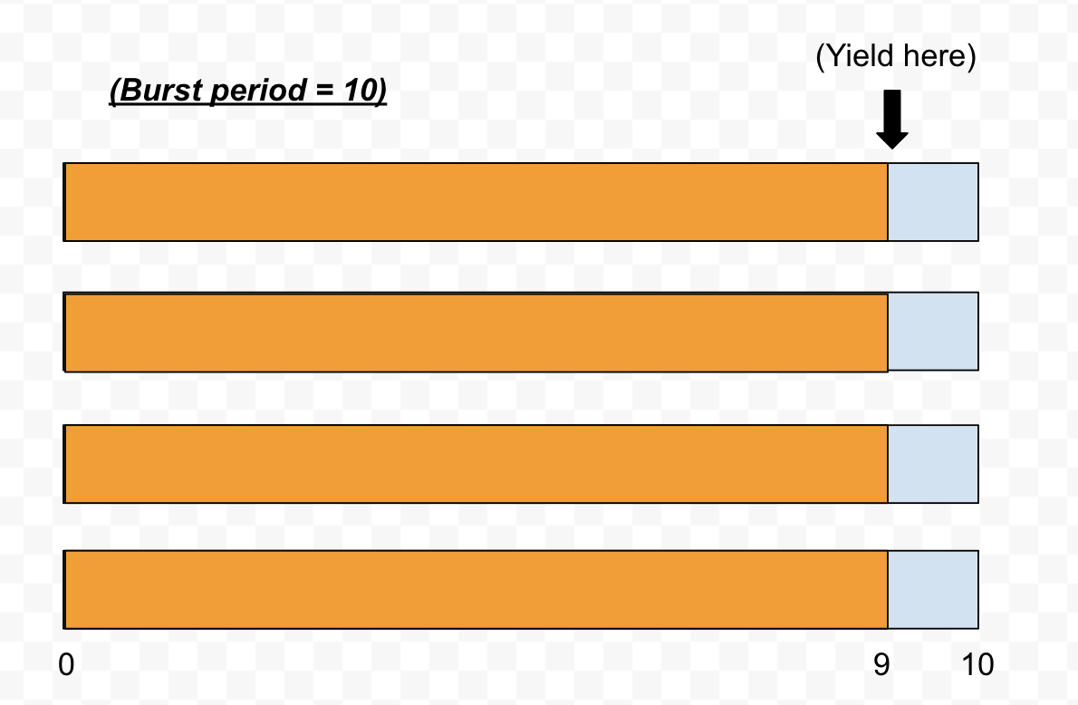
Gaming (playing the rule)
A process deliberately yields before burst period ends.
Some MLFQ doesn’t account for this:

Slide 10

Multiple CPUs
Each cpu runs process from a particular queue or a particular queue subset (inversely, also CPU affinity)
Busy CPU offloads job to idle cpu

Slide 11

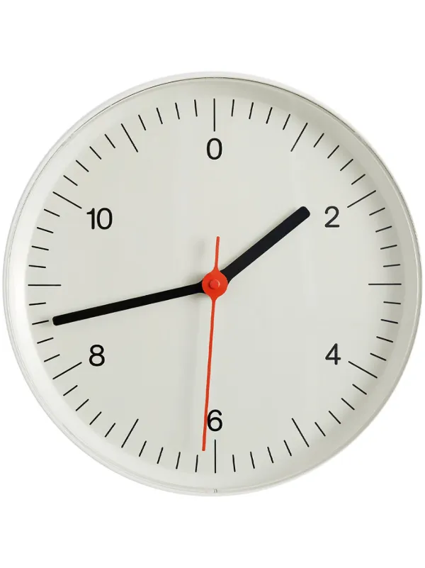

Other policy
Deadline aware scheduler (prioritise task which ever is more urgent)
Real-Time Scheduler uses nice value (from -20 to 20, which describes the relative importance) or static priority (from 0-99 like an absolute importance)
Linux CFS: use virtual runtime (who received the least service so far?) (use ordered tree to find such process)
Linus EEVDF: use virtual deadline (who’s request is more likely to due first so far?) (use ordered tree to find such process) Latency improves compared to CFS.

Slide 12
Memory
Delivered Jinghao Jiang

Slide 13
Memory
Memory space is shared between processes, but each process see its memory as if it was private. (We call this the address space of a process)
Memory aware by the process is virtual memory, they get translated to physical memory by the memory management unit (MMU).
Memory is byte addressable, each memory address maps to a byte

Slide 14
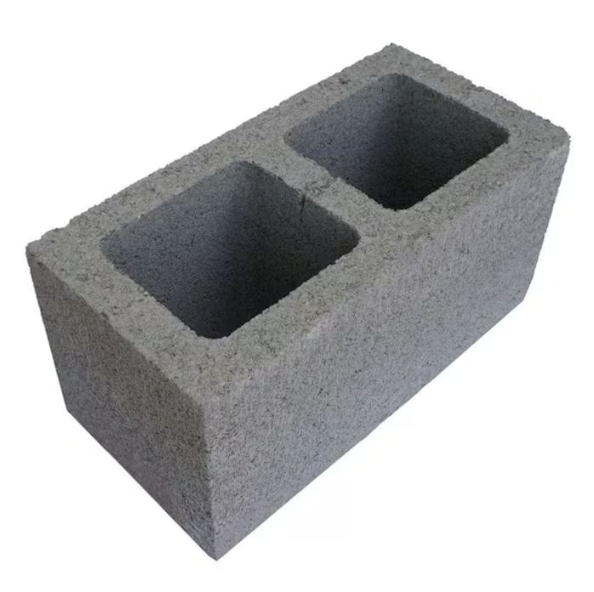
Memory page
A fix size block of memory, a block of virtual memory is called a page, a block of physical memory is called a frame
Page table records the mapping of a page to a frame.

Slide 15
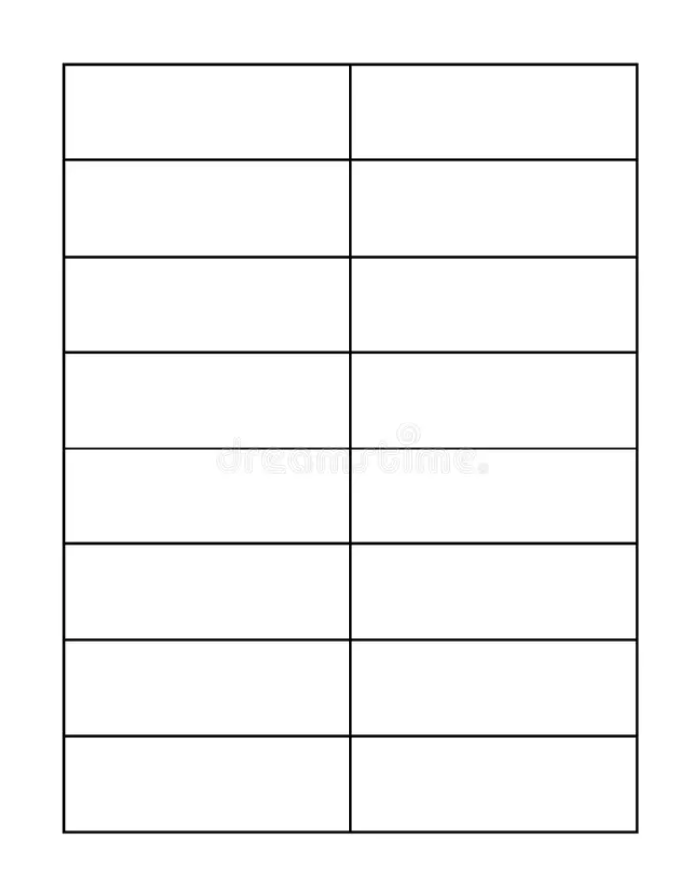
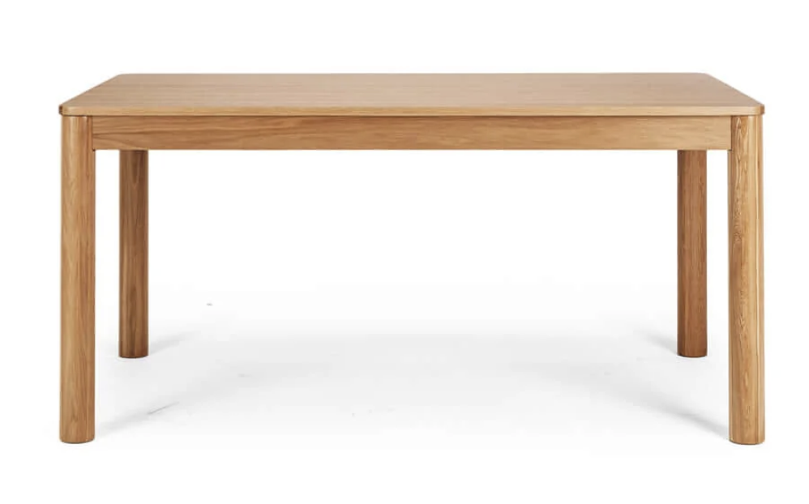

Page table
It’s a mapping table, the virtual address itself partially becomes the index of the table. The corresponding value is the physical frame number.
The length of the virtual address depends on the architecture, for example, my M2 mac is arm64, so it uses 64 bits to represent the a virtual address
Virtual address ≈ virtual page number + offset, page and frame on a device have the same size, this size determines the length of offset.

Slide 16

Problem
Page table is created process-wise. Each process only make use of few entries of that table, those empty slot can occupy a lot of memory
Solution: fit a page table into a page; split virtual address into indices.
Page table look up is slow, another smaller cache is used to store recently accessed virtual page numbers, this cache is called translation lookup buffer. (Cache is cleared during context switch)

Slide 17
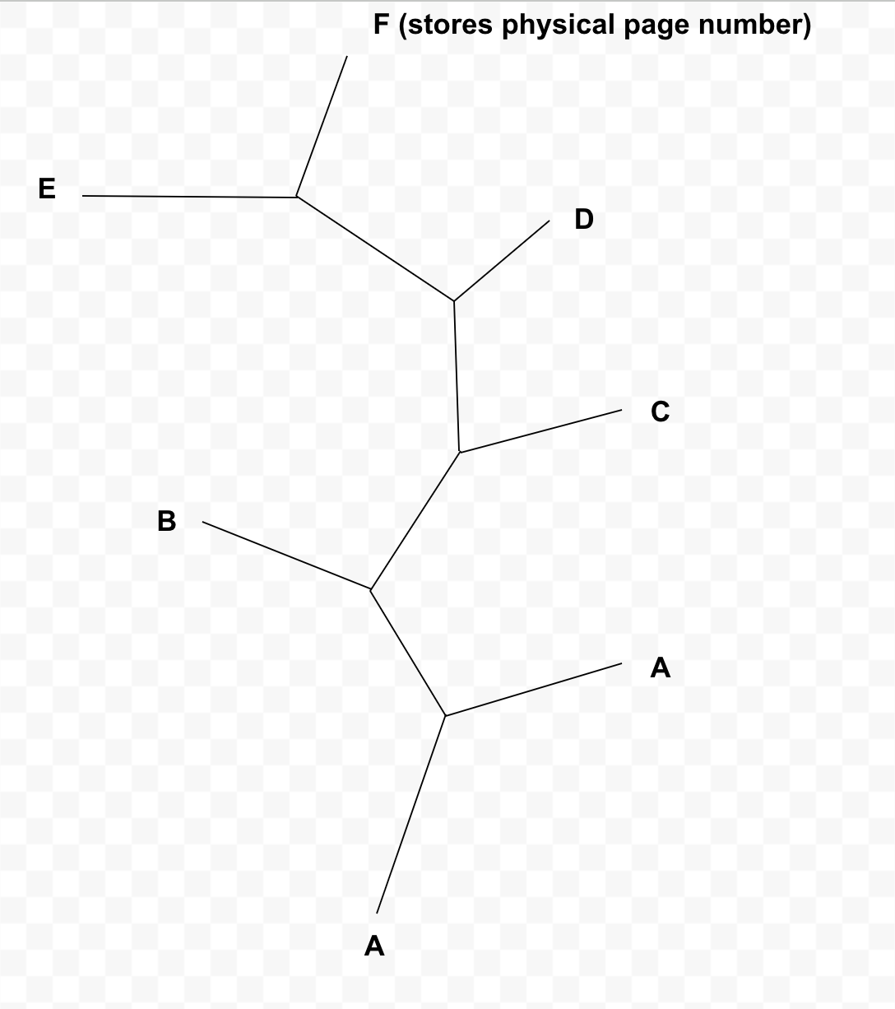
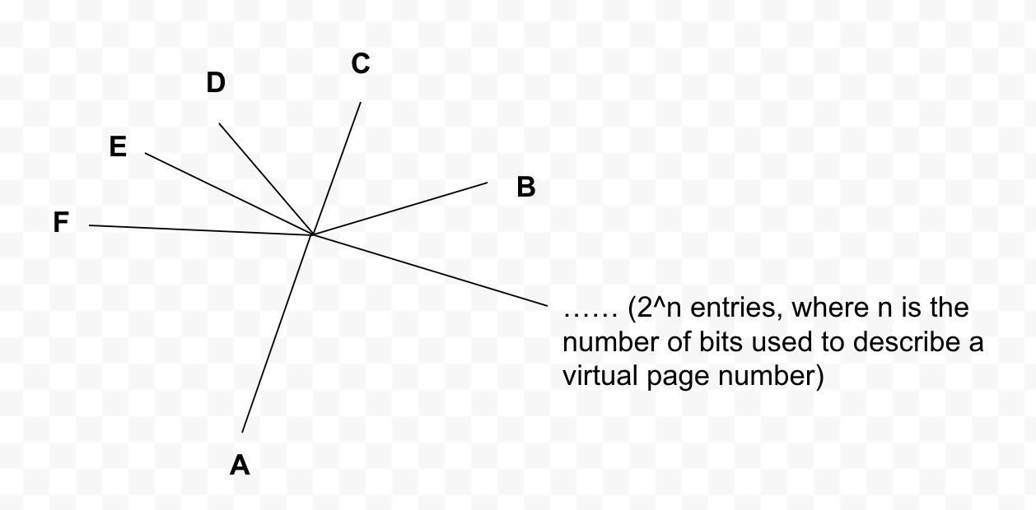
Visualisation

Slide 18

Attendance

Slide 19
Practice question 1
Let r be the request period, n be the nice value, and t be the virtual start time which of the following best describs virtual runtime and virtual deadline ?
virtual runtime = cpu time * n; virtual deadline = t + rn
virtual runtime = cpu time / n; ; virtual deadline = t/r + n
virtual runtime = cpu time + n; virtual deadline = t + n/r
virtual runtime = n/cpu time; virtual deadline = t + r/n

Slide 20
Practice question 2
Which of the subsequent scenarios is likely make MLFQ without periodic priority boost (multi level feedback queue) into trouble?
Begin a short job then continuous(infinite) long jobs arriving
Begin with a bunch(finite) of long jobs then a short job arrives
Begin a long job first then continuous(infinite) short jobs arriving
Begin with a bunch(finite) of short jobs then a long job arrives

Slide 21
Practice question 3
What does gaming refers? (Hint, gaming is a concept of multi level feedback queue, MLFQ), select the most accurate.
Long jobs blocked by short jobs
Process yield cpu to other process in a specialized pattern
Each queue maintain an unbalanced queue of process, which ends up with each cpu to have unbalanced workload, gaming helps to shuffle the work load between different queues.
A process occupies cpu and never give the cpu to other process by a special trick

Slide 22
Practice question 4
Suppose the time to access a translation lookup buffer is 20ns, and the cache hit rate is 70%, each memory access is 90ns. What’s the expected time to fetch the physical memory if using a 4-level page table?

Slide 23
Practice question 4
Time for hit: 20 + 90 = 110 ns
Time for miss: 20 + 5 * 90 = 470 ns
0.3 * 470 + 0.7 * 110 = 218 ns

Slide 24
Practice question 5
Use page size = 4KiB, 27 VPN bits, represented by , What’s the ratio of memory size needed for a single level page table and a 4 levels page table? One byte is accessed. Compute ratio as (memory need by single level / memory needed by multi level), represent as a power of 2, i.e. 2 ^ n.

Slide 25
Practice question 5
Single level: 27^2 * 8 = 2^30
4 level: 4 * 4096 = 2^2 * 2^12 = 2^14
2 ^ ( 30-14) = 2^16

Slide 26
Practice question 6

